Slide 1
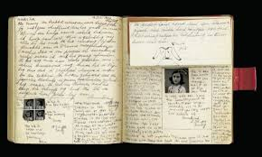
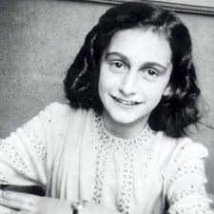
Anne Frank
The story of her life

Slide 2
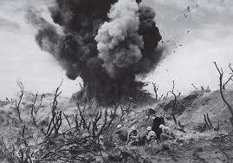
World War II
- started in 1939
-Ended in 1945
-Hitler

Slide 3
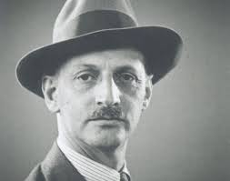
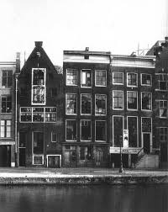
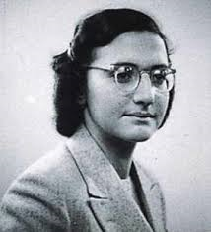
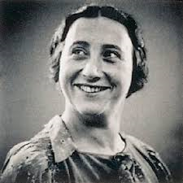
Birth and Death
Born June 12th 1929
Died March 1945
Family members Otto Frank, Edith Frank and Margot Frank

Slide 4
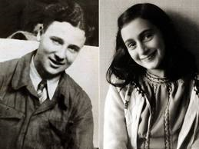
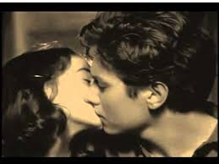
Love Life
Loves Peter Van Daan
Bram’s is 17, almost 18
He kissed Anne on the cheek
Peter Van Daan kissed Anne on the lips

Slide 5
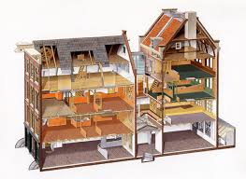
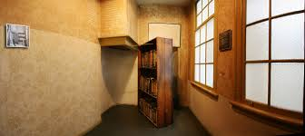
The Struggle, Living in Hiding
Went into hiding in 1942
Mrs. Van Daan was very annoying
Shortage of food
Personal struggles
a. depression
b. desperation for love (Peter Van Daan)
c. not close with her mother

